Slide 1
Announcements
Lab 2 is graded
Next week is the first night lab!
Intro to the Night Sky
Meet here (normal classroom) at 7:30 - Make sure to be on time, roof access is complicated right now due to construction…
Remember to bring your starwheel and (if desired) a red flashlight
Strongly recommend printing this one so you don’t use your laptop/tablet on the roof
Also some sketches that will be a lot easier to do by hand
Though I will give credit for almost anything better than the AI generated ASCII art of the southern (hemisphere) sky I saw last semester
I will send a reminder announcement in Canvas day of

Slide 2
Parallax and Proper Motion

Slide 3
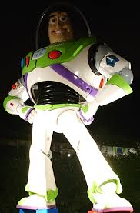
(Linear) Distance in Astronomy
Astronomical Unit (AU) = distance between Earth and the Sun = 150 billion meters
Lightyear (ly) = the distance light travels in one (Earth) year = 64321 AU = 9.5 quadrillion meters
300 million meters per second (speed of light) times 31.5 million seconds (one year)
Unit of distance (or length, if you prefer)
Parsec (pc) = 3.26 light years = 206265 AU = 30 quadrillion meters
Comes from parallax - part of what we are doing today
Name is a portmanteau of “parallax” and “arcsecond”
Notes:
Image credit: Wikipedia, Jan. 29 2026

Slide 4
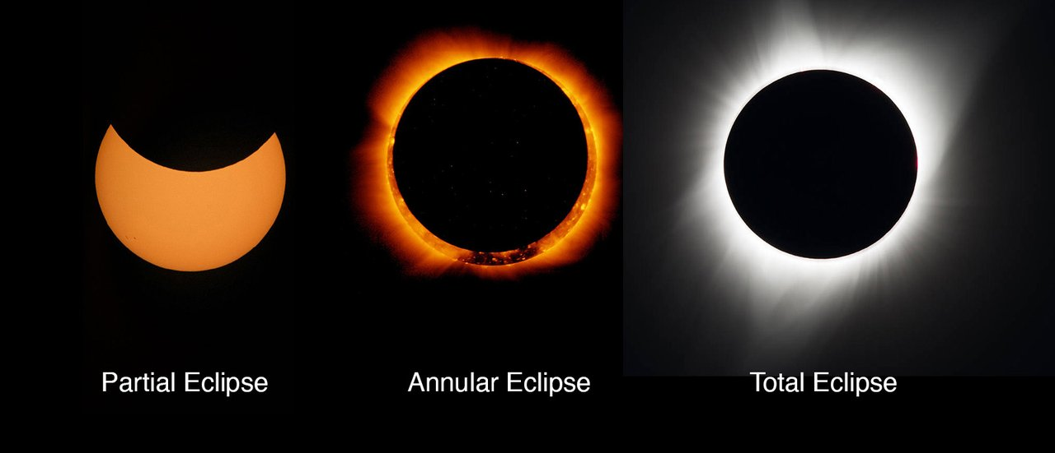
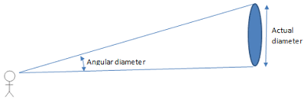
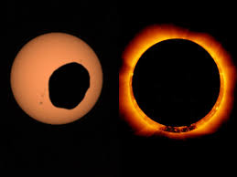
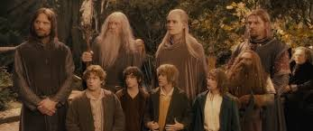
(Angular) Distance in Astronomy
In astronomy, we often talk about the size of things in terms of how big they appear to be
Think of it as yourself being one point in a triangle, the edges of the object you are looking at are the other two
The angle of that triangle is the angular size/distance
This will come up more in later labs
Units - degrees are broken into arcminutes and then arcseconds
1 degree (°) = 60 arcminutes (‘) = 60 arcseconds (“)
The other way to think about this is “forced perspective”, things look smaller when they are further away
The Sun is ~400 times wider than the Moon, it’s also ~400 times further away, so they both appear the same size
Martian Solar Eclipse
Often used in film to make certain actors or objects look bigger/smaller than they actually are
Tallest actor in the scene
Notes:
The difference between the tallest actor, and the shortest actor in that image is 6” (6’1” vs 5’7”)
Image credit: Lord of the Rings: Fellowship of the Ring (characters), JPL (three eclipses), Business Insider (Martian Eclipse), Stig’s Sky Calendar (Diagram) - all Feb. 2 2026

Slide 5
Apparent Motion and Parallax
The way something appears to move
Due to things other than its movement
Close one eye, hold your arm out and cover the star with your thumb
Now switch eyes
Still covered?
That “apparent motion” is parallax
Can also demonstrate with a pen or pencil held close to your face
With both eyes, you may or may not see double - try switching between eyes to see if it moves
Because you have 2 eyes with a small distance between them - they don’t see quite the same things

Slide 6
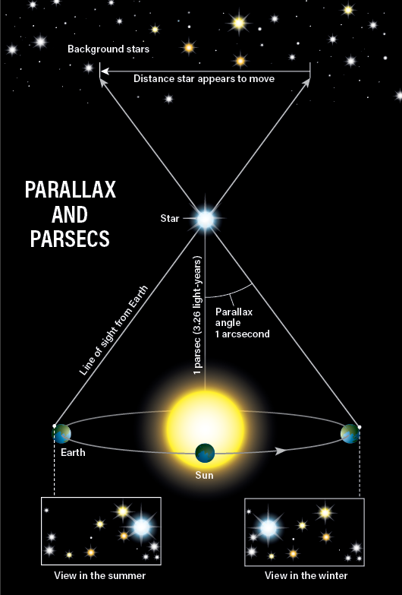
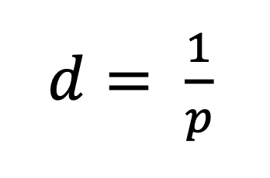
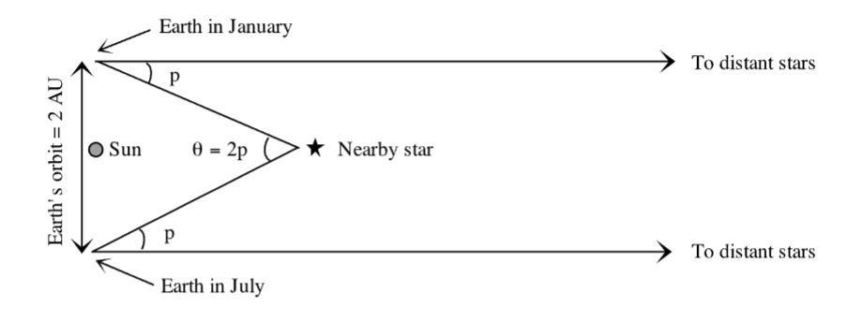
Parallax in Astronomy
Instead of the distance between your eyes, it's the distance between two ends of Earth’s orbit
So 2 AU instead of a few centimeters
Closer stars “move” more than further ones
Distance (in pc) is equal to 1 divided by the angle (in arcseconds)
Notes:
Image Credit: Lab Script (White Background), Cosmos at Your Doorstep (Black background) - Both Jan, 29 2026

Slide 7
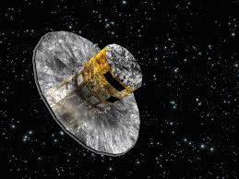
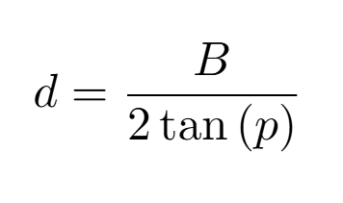
Parallax in Astronomy Cont.
Too small to see with the naked eye
↑ Why the Ancient Greeks thought the Earth didn’t move (Geocentrism)
With telescopes, we can use it to measure the distance to stars
Max distance with current telescopes (Gaia) is about 125000 pc - hypothetically
Actually reliable distance: ~10000 pc
Only a third of the Milky Way’s full diameter
In addition to telescope capabilities, baseline distance also matters
2 AU for the Earth
Increase in max parallax distance is directly proportional to baseline distance
Or trigonometry!
*cough* Question 18 *cough*
Gaia Space Telescope →
(artist’s rendition)
Notes:
Image credit: Encyclopedia Britannica (Gaia), myself (equation) - both Jan. 29 2026

Slide 8
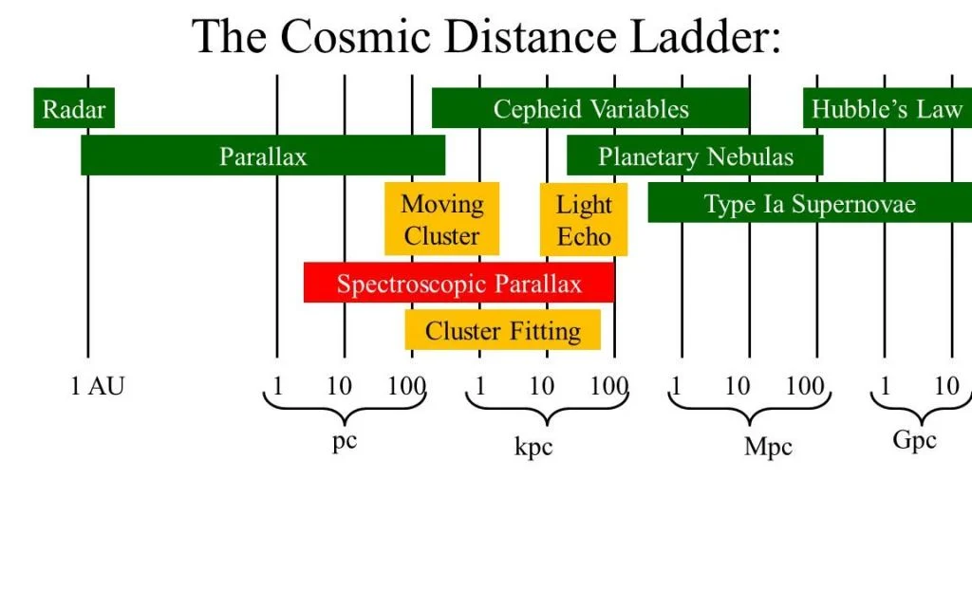
Cosmic Distance Ladder
Current best parallax only gets us a third of the way across the Milky Way
So how to we now about the distance to things outside of it?
Notice how the different methods overlap
This is how we “calibrate” each one from biggest to smallest
Not hugely important for this lab, but we will come back to it (or something similar) for 5 more labs this semester
Magnitudes and Stellar Brightness, Variable Stars, H-R Diagrams, Open Clusters, Hubble Expansion
Notes:
Image credit: Universe Today - Jan. 29 2026

Slide 9
Today (Exercise 1: Parallax) (1 hour-ish?)
Lots of math
Especially unit conversions
Feel free to use a calculator
Show work for guaranteed at least partial credit
Question 7: Don’t worry about showing work, the answer is in the definition of a parsec
Questions 8-10: can use a ruler or just make a best estimate
Question 12: Parallax of Alpha Centauri (Also in lab script) = .75 arcsec
Question 18: Two ways to solve
Small angle approximation: sin(𝛳) ≈ 𝛳 and tan(𝛳) ≈ 𝛳
Makes trigonometry a lot easier/simpler
This is what the question means by “Assume small angles.”
Proportionality (ratios)

Slide 10
STOP; END OF PART 1

Slide 11
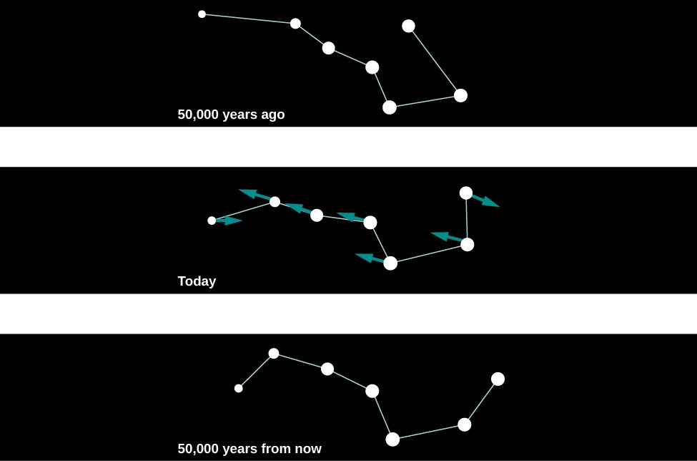
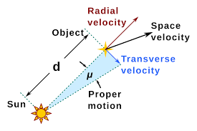
Proper Motion
Actual movement
But angles cause issues
We don’t actually see the full movement
If it’s coming straight at (or away from) you, you won’t see any movement
If it’s moving 90° relative to you, then you can see all the movement
So it’s actually usually moving faster than you can see
Notes:
Image credit: University of Oregon (Big Dipper) and Wikipedia (diagram) - both Feb. 2 2026

Slide 12
Starry Night and a Spreadsheet
Follow directions in the lab script
Instead of a 2 degree field of view, use the box in the top right to go to 3°X1°, then zoom in slightly to get to 2°X1°
May need to zoom out for faster stars
The red numbers on top of the angular separation measurement are
Degrees (°), arcminutes (‘), and arcseconds (“)
Type them into the labelled yellow cells at the bottom of the spreadsheet
To the right of this will give a value in just arcseconds
This is the number you want to plug into the main spreadsheet
Get the distance from Earth based on the blue text from hovering over the star

Slide 13
Today (Exercise 2: Proper Motion)
Will need to work in pairs, maybe groups of 3
Not all the class computers work
When you open Starry Night, do not update, do not register
This is old software, we don’t want to break it
When you open the spreadsheet, do not ask for edit access
Open in Google Sheets and make a copy or download it and open in Excel
Make sure to turn in the spreadsheet
Can be a second file or tacked onto the end of the lab script
Still needs to be a PDF

